Slide 1
Why is there so much evil in the world?
Travis Dickinson, PhD
www.travisdickinson.com

Slide 2
www.travisdickinson.com
FREE book for signing up for my newsletter!!

Slide 3
Why God?
Question: Why is there so much evil, pain and suffering in the world?
The world can seem God-less at times!!
Notes:
Bike riding example

Slide 4
Why God?
War
School shootings
Child abuse
Drug abuse
Spousal abuse
Crime
Sex trafficking
Car accidents
Anxiety
Cancer
Covid19
Heart attacks
Aneurisms
Old age
Fires
Earthquakes
Starvation
Tsunamis

Slide 5
Why God?
Answer: God has good and justifying reasons for all of the evil, pain and suffering.
Notes:
Bike riding example

Slide 6
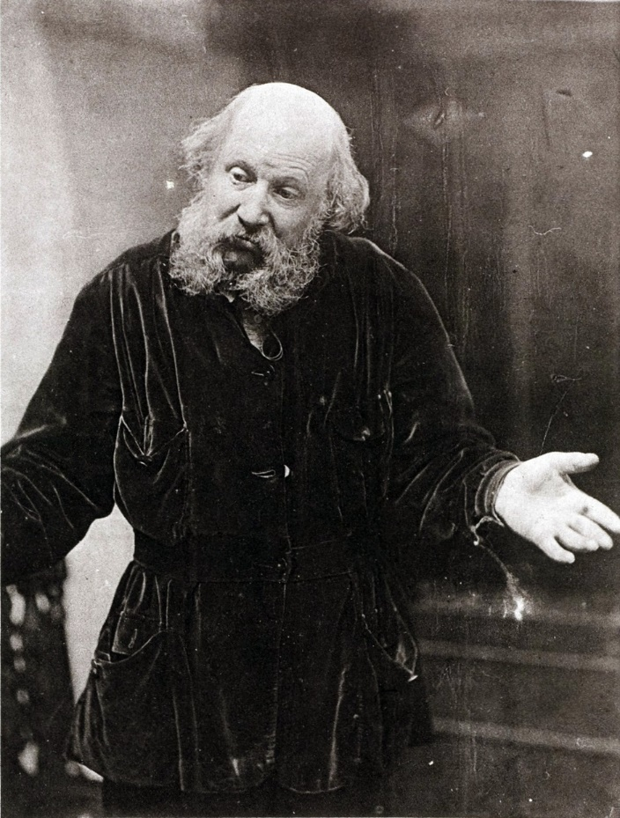
Permission to Doubt Your Faith
We won’t get it all figured out.
And that’s okay!!
You need enough of your questions answered to trust.
Notes:
We need reasons to get on board. We need reasons for faith.

Slide 7
Why God?
Why do bad things happen?
We live in a fallen world.
Human freedom.
Ultimately, it’s all for the glory of God!

Slide 8
1. A Fallen World
From a Biblical perspective, the world itself is fallen.
Genesis 3:17
“Cursed is the ground because of you…”
Romans 8:18-25
“…creation was subjected to futility” v. 20
“…the whole creation groans and suffers the pains
of childbirth together until now” v. 22
Notes:
In a fallen world, fallen things happen.

Slide 9
2. Human Freedom
Bad things happen because…
God created us with the freedom to choose
And we freely chose to sin.
But why didn’t God create us to just do good?

Slide 10
2. Human Freedom
We are created for relationship with God.
John 17:3 “And this is eternal life that they may know you, the only true God, and the one you have sent —Jesus Christ.”
Notes:
With humans, the world was “very good indeed” (Gen. 1:31).

Slide 11
2. Human Freedom
Without free choice, there’s not genuine relationship.
Forced love is not love at all.
But with free choice, there’s the possibility of evil.
Notes:
Dating example
God could have created robots. But he loves you too much!!

Slide 12
2. Human Freedom
A world with the possibility of knowing God is arguably the best possible world.
So, God allowed a significant degree of evil, pain and suffering for a relationship with you!

Slide 13
3. The Glory of God
Bad things happen because…
Ultimately, it’s part of the good plan of God.
Really important: You are part of the plan, but it is NOT primarily about you!
Notes:
Prosperity gospel
we all have a little PG in us…flawed biblically but it also doesn’t work.
Paradox of hedonism

Slide 14
3. The Glory of God
Every problem of evil assumes that God owes us some degree of happiness and pleasure.
But does God owe us happiness?
No!
Notes:
God can’t do evil, of course. But can God curse the world because of sin?
I’m suggesting that suffering is not itself evil. It’s prosperity gospel to think God’s job is to make us happy.
As it turns out, God, in his grace, makes us whole when we are rightly oriented to God by the work of Jesus on the cross.

Slide 15
Why God?
But we still don’t have specific reasons why things like school shootings, tsunamis, car crashes and cancer happen.
We don’t need specifics so long as we know God to be good and in control.
Notes:
They may not help as much as you think they would.

Slide 16
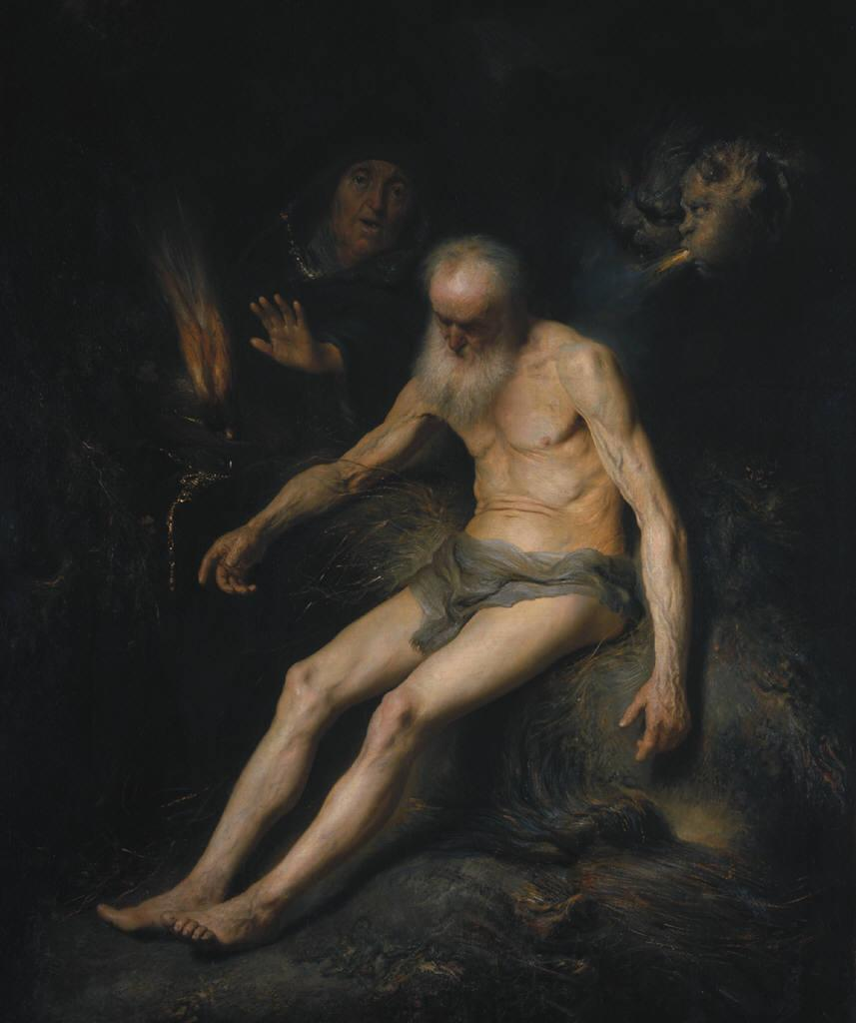
Job
What answers does Job get?
The knowledge of God

Slide 17
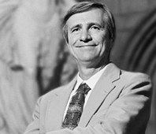
Why God?
“He came. He entered space and time and suffering. He came, like a lover. Love seeks above all intimacy, presence, togetherness. Not happiness. ‘Better unhappy with her than happy without her’—that is the word of a lover. He came. That is the salient fact, the towering truth, that alone keeps us from putting a bullet through our heads. He came. Job is satisfied even though the God who came gave him absolutely no answers at all to his thousand tortured questions. He did the most important thing and he gave the most important gift: himself.” (Peter Kreeft, Making Sense Out of Suffering)

Slide 18
The Good News
Is God going to show up for us like he did for Job?
Yes, he already has!
In this, we have hope.
Notes:
Grieve Not as Those Who Have No Hope 1 Thess. 4:13

