Slide 2
Wandering Toward God
Finding Faith amid Doubts and Big questions
Travis Dickinson
www.travisdickinson.com

Slide 3
Let’s take a trip!

Slide 4
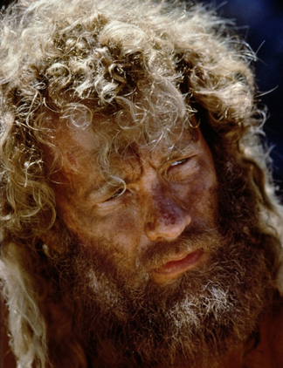
Notes:
You notice someone who looks oddly like Tom Hanks in the movie Castaway (he’s been there a while) who you’ve also noticed never seems to board a flight. So you engage this person and he raises a series of questions that you’ve never thought about before.
Do you know how much an airplane weighs? 1 million pounds
Do you know what an airplane is made of? Mostly steel (heavy stuff)
Do you know how many things have to be timed perfectly for a plan to function at all? 100s of thousands of processes having to work with pinpoint accuracy or you fall out of the sky
Is it your experience that typically things weighing a million pounds, being made of steel, requiring pinpoint accuracy with 100s of thousands of processes are able to cruise 6 miles off the ground?
Have a great flight. You’d be a dummy to entrust your life to this sort of thing!

Slide 5
Walking away
64% of Christian youth are walking away from the church in college (Barna Study).
Why?

Slide 6
Walking away
The church is not always a safe place to doubt and deeply question faith.
Notes:
One of the top 6 reasons identified by Barna was The church feels unfriendly to those who doubt. https://www.barna.com/research/six-reasons-young-christians-leave-church/
The others involved issues of doubt:
Reason #3 – Churches come across as antagonistic to science…“Christians are too confident they know all the answers” (35%)

Slide 7
What is doubt?
When it seems as if a belief might be false.
Feeling the pull or force of an objection.

Slide 8
The Value of Doubt
If you doubt, you’re normal!!
Doubt, when handled properly, leads to…
…truth and knowledge.
…an even greater faith.
Notes:
If you don’t doubt, that’s fine, it may be time to ask some difficult questions.

Slide 9
How to Doubt Well
Hang on!
You can doubt and have (100%) faith at the same time.
Notes:
Would you get on the flight?
I’m not saying ignore the challenge. You’ll need to address the problem. How’s the best way to do this? In community…this leads to my next point.

Slide 10
How to Doubt Well
Doubt your doubts
Doubts need evidence to be effective!
Notes:
We need to ask what reasons we have for believing the doubt is true.
It is practically impossible that you will stumble on a problem that no one in the history of Christianity has ever worked on. You are not alone in this.
I have sometimes found students struggling deeply with a challenge that has been so thoroughly addressed that most non-Christians don’t even think it is a good argument.
Or it is something that Augustine thoroughly refuted 16 centuries ago (4th century).
What do you think about the problem of evil? How do you reconcile alleged contradiction in Scripture? Is there such thing as truth and can I know it? How can we reasonably believe in miracles in our modern scientific age? What do I say to the Catholic or the Mormon or the JW or Muslim?

Slide 11
How to Doubt Well
Keep in mind…
You don’t need 100% certainty to believe rationally.
Don’t doubt alone…you need community.

Slide 12
How to Doubt Well
Take it one question at a time.
Doubt in the posture of a seeker.
- Not as a skeptic or cynic.

Slide 13
Deconstruction?
What is deconstruction?
Is deconstruction good or bad?

Slide 14
Deconstruction?
Worries:
Does deconstruction just mean “on the way to deconversion”?
It’s a fundamentally negative project and, thus, incomplete.
People are often inconsistent with their high demand of evidence.

Slide 15
Deconstruction?
How about this?
Deconstruction: taking a hard and honest look at our Christian beliefs.

Slide 16
Doubt
In the words of Jesus…
Matt. 22:37-38: Jesus replied: “‘Love the Lord your God with all your heart and with all your soul and with all your mind.’ This is the first and greatest commandment.

Slide 17
Doubt
Is it dangerous to doubt?
It may be more dangerous not to doubt or at least ask the questions.
Christianity can handle your biggest questions and hardest doubts.

Slide 19
www.travisdickinson.com
FREE book for signing up for my newsletter!!
Notes:
Mental health issues??…but the point is that the success and wealth did not compensate for mental health struggles.

