Slide 1
The God-shaped hole
How the gospel satisfies our deepest longings
Travis Dickinson
www.travisdickinson.com

Slide 2
Robin Williams

Slide 3
Marilyn Monroe

Slide 4
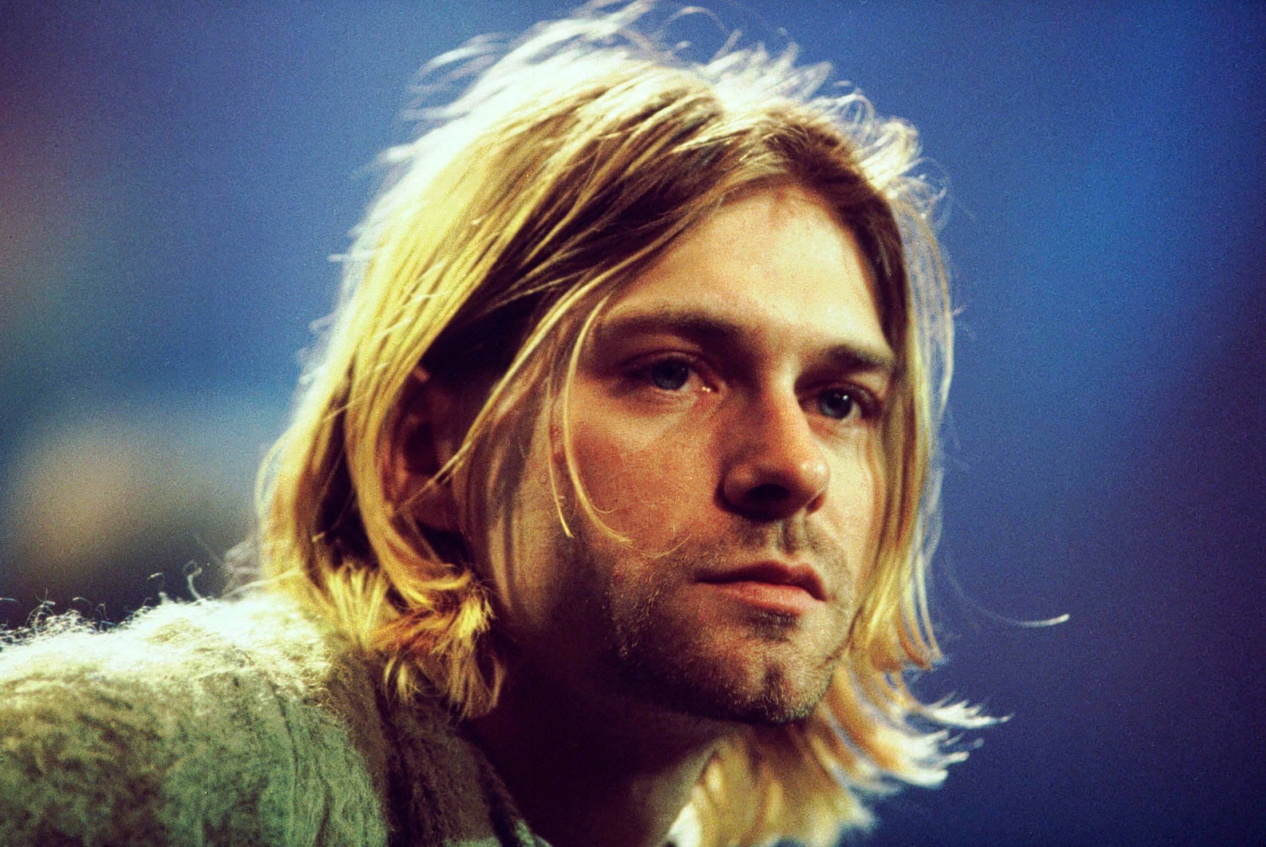
Kurt Cobain

Slide 5
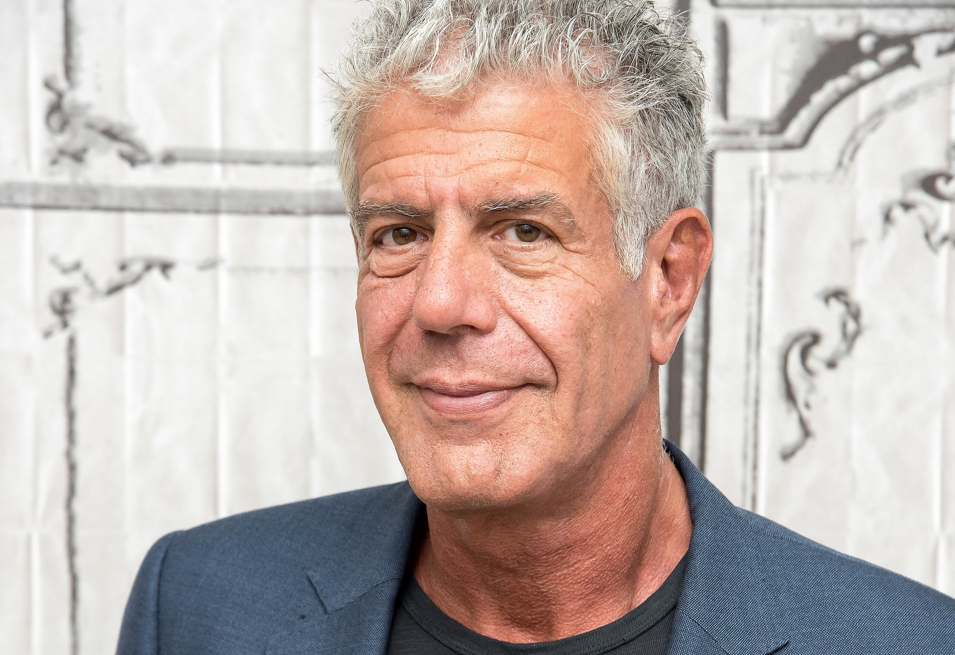
Anthony Bourdain

Slide 6
Lil’ Chris

Slide 7
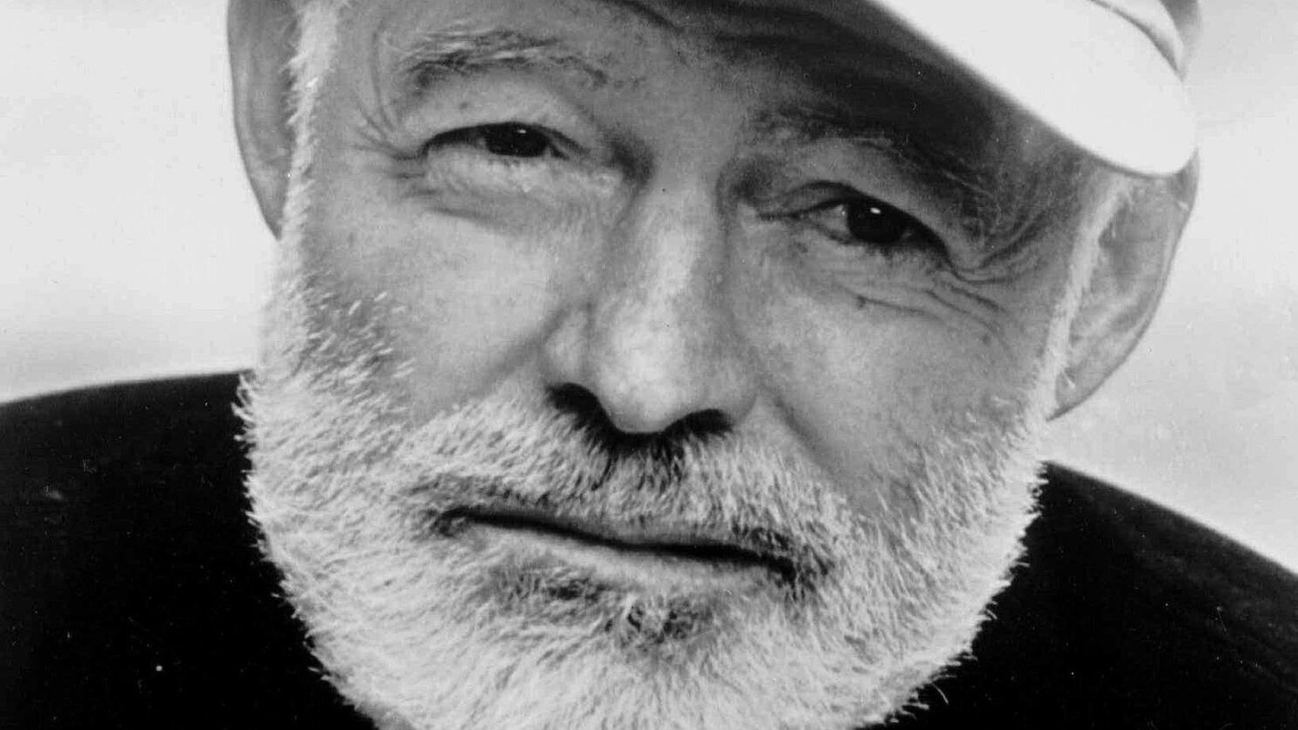
Ernest Hemingway

Slide 8
www.travisdickinson.com/slides
Notes:
Mental health issues??…but the point is that the success and wealth did not compensate for mental health struggles.

Slide 9
The God-shaped Hole
Each found tremendous success and each committed suicide!!
Success, wealth, and the all the pleasures of the world do not satisfy.
We’ll always want more and it’s always just out of reach!!
Notes:
Mental health issues??…but the point is that the success and wealth did not compensate for mental health struggles.

Slide 10
The God-shaped Hole
“All complain, princes and subjects, noblemen and commoners, old and young, strong and weak, learned and ignorant, healthy and sick, of all countries, all times, all ages, and all conditions.”
~Blaise Pascal

Slide 11
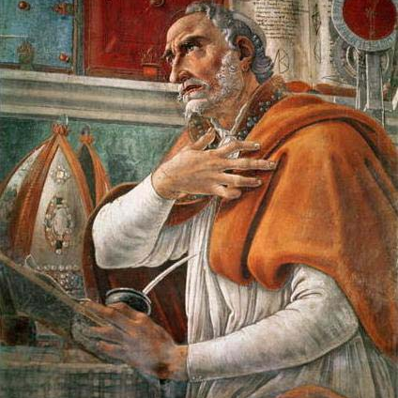
St. Augustine
“You have made us for Yourself, O Lord, and our heart is restless until it rests in You.”
Notes:
St. Augustine (354-430)
Augustine’s restless heart. He had fame and fortune but he especially liked…girls.
Reading philosophy actually gave him a taste for something better. He describes it as a yearning “with unbelievable ardor for the immortality of wisdom.” He longed for truth not finding in fame, fortune or women.
He sought for this in academics and religion, but still did not find it.
It was only after he embraced the gospel that he said

Slide 12
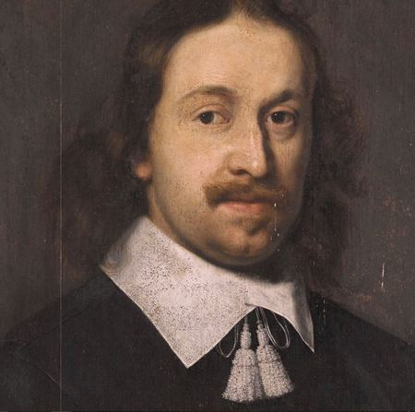
Blaise Pascal
“What is it then that this desire and this inability proclaim to us, but that there was once in man a true happiness of which there now remains to him only; the mark and empty trace, which he in vain tries to fill from all his surroundings, seeking from things absent the help he does not obtain in things present?”
Notes:
17th century, Blaise Pascal was quite successful in math and science. He was an intellectual Christian but had never surrendered fully to Jesus.
He gives up his pursuits in math and science and focuses solely on apologetics and theology.
Unfortunately he dies at the age of 39 and his major work in apologetics, the Pensees, is unfinished. People quote from it all the time but they are quoting from his notes.
“All men seek happiness. This is without exception. Whatever different means they employ, they all tend to this end. The cause of some going to war, and of others avoiding it, is the same desire in both, attended with different views. The will never takes the least step but to this object. This is the motive of every action of every man, even of those who hang themselves. Please provide complete bibliographic information for this quote.”

Slide 13
Blaise Pascal
But these are all inadequate, because the infinite abyss can only be filled by an infinite and immutable Object, that is to say, only by God Himself.”

Slide 14
Not-Pascal
“There is a God-shaped hole in the heart of each man which cannot be satisfied by any created thing but only by God the Creator, made know through Jesus Christ.”

Slide 15
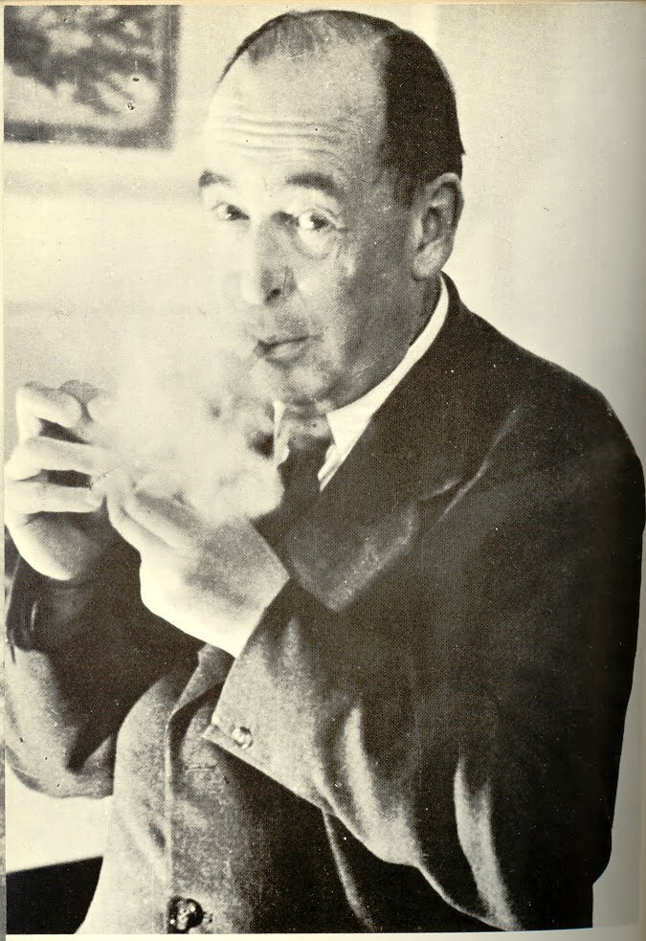
C.S. Lewis
“Nearly all that I loved I believed to be imaginary; nearly all that I believed to be real I thought grim and meaningless; I care[d] for nothing but the gods and heroes, the garden of the Hesperides, Launcelot and the Grail but believe[d] in nothing but atoms and evolution and military service.”
Notes:
1898-1963
- Oxford don, a Literature specialist with an interest in pagan mythology.
- He loved the myths because of meaning and significance they provided but they were false. His atheism said the world was simply molecules in motion.

Slide 16
The God-shaped Hole
Lewis found in himself….
Joy
Desire for the infinite.
“
”
??
Notes:
What he found in himself was an unshakeable desire for something he couldn’t find in this world…he called this desire “Joy”…we’ll call this the desire for the infinite.
Success didn’t satisfy.
Money and the pleasures of this world didn’t satisfy.
Scientific knowledge about the world didn’t satisfy.

Slide 17
The God-shaped Hole
One may say, “Although I am not perfectly happy now, I believe I would be if only I had ten million dollars, a Lear jet, and a new mistress every day.” The reply to this is, of course, “Try it. You won’t like it.” It’s been tried and has never satisfied. In fact, billions of people have performed and are even now performing trillions of such experiments, desperately seeking the ever-elusive satisfaction they crave. For even if they won the whole world, it would not be enough to fill one human heart.
~Peter Kreeft
Notes:
We can numb the feeling with things but nothing finite fills it. Peter Kreeft has said:

Slide 18
C.S. Lewis
For every desire, there exists an object that satisfies that desire.
“A baby feels hunger; well, there is such a thing as food. A duckling wants to swim; well, there is such a thing as water. Men feel sexual desire; well, there is such a thing as sex.”

Slide 19
C.S. Lewis
“If I find in myself a desire which no experience in this world can satisfy, the most probable explanation is that I was made for another world.”

Slide 20
Argument from Desire
For every desire, there’s something that satisfies the desire.
We all have an ultimate desire that no finite thing can satisfy.
Therefore, there is an ultimate and infinite thing that satisfies this desire.

Slide 21
Argument from Desire
For every desire, there’s something that satisfies the desire.
We all have an ultimate desire that no finite thing can satisfy.
Therefore, there is reason to believe there’s an ultimate and infinite thing that satisfies this desire.
Notes:
I’m all ears for possible contenders for the infinite object?
What do you think? “the single most intriguing argument in the history of human thought.”
Many people don’t like the generalization in premise 1

Slide 22
The Best Explanation?
Curious fact :
We all have a desire
for something infinite.
What best explains this curious fact?
Evolution?
God created us to desire him and become whole?
Notes:
Even if tied, the gospel is preferrable.
Add this line of evidence along with the rest of the case…single thesis explains moral facts, logic, universe, fine tuning, design of universe, beauty, consciousness, love, etc.
AND it really satisfies.

Slide 23
C.S. Lewis
Our Lord finds our desires not too strong, but too weak. We are half-hearted creatures, fooling about with drink and sex and ambition when infinite joy is offered us, like an ignorant child who wants to go on making mud pies in a slum because he cannot imagine what is meant by the offer of a holiday at the sea. We are far too easily pleased.

Slide 24
Walking Off a Broken Leg
The Christian gospel is the perfect fit for our human predicament.
Unlike all other religions, the Christian gospel says “STOP!”
You don’t have to do anything to be whole.
You are saved by grace through faith…it is God’s gift— not from works (Eph. 2:8-9)
Notes:
You are saved by grace through faith, and this is not from yourselves; it is God’s gift— not from works, so that no one can boast. (Eph. 2:8-9)

Slide 25
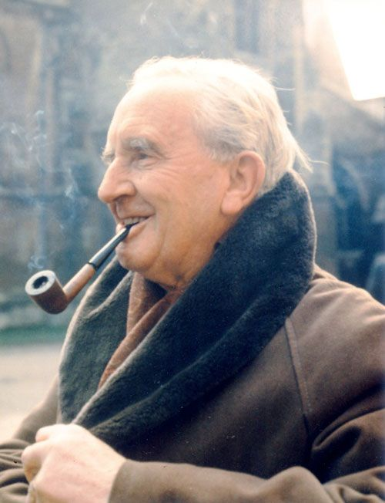
J.R.R. Tolkien
This story begins and ends in joy. It has pre-eminently the ‘inner consistency of reality’. There is no tale ever told that men would rather find was true, and none which so many sceptical men have accepted as true on its own merits. For the Art of it has the supremely convincing tone of Primary Art, that is, of Creation. To reject it leads either to sadness or to wrath.

Slide 26
www.travisdickinson.com
New book!!
Notes:
Mental health issues??…but the point is that the success and wealth did not compensate for mental health struggles.

Slide 27
www.travisdickinson.com
FREE book!
Notes:
Mental health issues??…but the point is that the success and wealth did not compensate for mental health struggles.

