Slide 1
The Truthfulness of the Bible
Travis Dickinson
www.travisdickinson.com

Slide 2
The Truthfulness of the Bible
Are there good historical reasons to trust the Bible?
Thesis: Yes, because…
The NT is grounded in eyewitness testimony.
It has the marks of authenticity.
Notes:
Not inerrancy

Slide 3
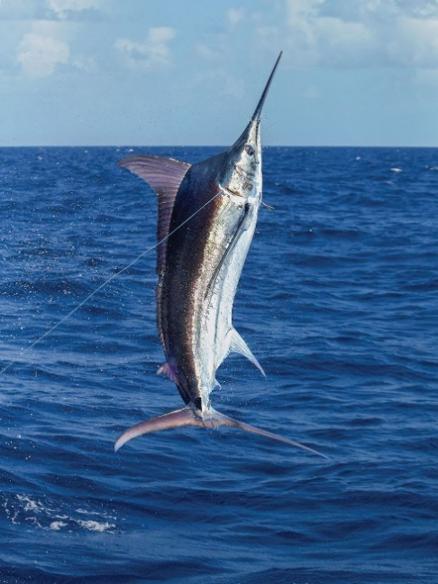
The Truthfulness of the Bible
Fish stories and eyewitnesses!
Notes:
Not inerrancy

Slide 4
It Claims to be from Eyewitnesses
Luke 1:1-4
1 Inasmuch as many have undertaken to compile an account of the things accomplished among us, 2 just as they were handed down to us by those who from the beginning were eyewitnesses and servants of the word,

Slide 5
It Claims to be from Eyewitnesses
Luke 1:1-4
3 it seemed fitting for me as well, having investigated everything carefully from the beginning, to write it out for you in consecutive order, most excellent Theophilus; 4 so that you may know the exact truth about the things you have been taught.

Slide 6
It Claims to be from Eyewitnesses
2 Peter 1:16-18
16 For we did not follow cleverly devised tales when we made known to you the power and coming of our Lord Jesus Christ, but we were eyewitnesses of His majesty.

Slide 7
It Claims to be from Eyewitnesses
2 Peter 1:16-18
17 For when He received honor and glory from God the Father, such an utterance as this was made to Him by the Majestic Glory, “This is My beloved Son with whom I am well-pleased”—

Slide 8
It Claims to be from Eyewitnesses
2 Peter 1:16-18
18 and we ourselves heard this utterance made from heaven when we were with Him on the holy mountain.

Slide 9
It Claims to be from Eyewitnesses
1 John 1:1-4
1 What was from the beginning, what we have heard, what we have seen with our eyes, what we have looked at and touched with our hands, concerning the Word of Life— 2 and the life was manifested, and we have seen and testify and proclaim to you the eternal life, which was with the Father and was manifested to us—

Slide 10
It Claims to be from Eyewitnesses
1 John 1:1-4
3 what we have seen and heard we proclaim to you also, so that you too may have fellowship with us; and indeed our fellowship is with the Father, and with His Son Jesus Christ. 4 These things we write, so that our joy may be made complete.

Slide 11
The truthfulness of the Bible
The New Testament dates early, REALLY early!
Important events:
  The Jewish Temple is destroyed in AD 70.
  Paul is executed in mid-60s.
  Extreme persecution in mid-60s.
  James is executed in AD 62.

Slide 12
It Dates Early
The book of Acts does not mention any of these events.
  Acts then is most likely written in the early 60s or before.
  Luke would be written before the early 60s.
  Mark is plausibly written by the mid to late 50s.

Slide 13
It Dates Early
Jesus is crucified in AD 30.
Thus, there is a complete Gospel within 20 to 30 years.
This is very likely within the lifetimes of eyewitnesses.

Slide 14
It Dates Early
But, we can get closer…
Paul’s letters date to the early to mid-50s.
Within 20 years, we have the core claims of Christianity.

Slide 15
It Dates Early
Jesus’s virgin birth (Gal. 4:4)
His titles of deity (Rom. 1:3-4; 10:9)
His sinless life (2 Cor. 5:21)
His death on the cross (Rom. 4:25; 5:8; Gal. 3:13)
That he died to pay for our sins (1 Cor. 15:3; 2 Cor. 5:21)
His resurrection on the “third day” (1 Cor. 15:6)
His post-resurrection appearances (1 Cor. 15:5-8)
That he is seated at the right hand of God (Rom. 8:34)

Slide 16
It Dates Early
We can get even closer…
Within the writings of Paul are certain early creeds.
  A memorable summary of events and theology.
1 Corinthians 15:3-7.

Slide 17
It Dates Early
1 Cor. 15:3-4
3 For I delivered to you as of first importance what I also received, that Christ died for our sins according to the Scriptures, 4and that He was buried, and that He was raised on the third day according to the Scriptures,

Slide 18
It Dates Early
1 Cor. 15:3-4
3 For I delivered to you as of first importance what I also received, that Christ died for our sins according to the Scriptures, 4and that He was buried, and that He was raised on the third day according to the Scriptures,

Slide 19
It Dates Early
1 Cor. 15:3-4
3 For I delivered to you as of first importance what I also received, that Christ died for our sins according to the Scriptures, 4and that He was buried, and that He was raised on the third day according to the Scriptures,

Slide 20
It Dates Early
1 Cor. 15:3-4
3 For I delivered to you as of first importance what I also received, that Christ died for our sins according to the Scriptures, 4 and that He was buried, and that He was raised on the third day according to the Scriptures,

Slide 21
It Dates Early
1 Cor. 15:5-7
5 and that He appeared to Cephas, then to the twelve. 6 After that He appeared to more than five hundred brethren at one time, most of whom remain until now, but some have fallen asleep; 7 then He appeared to James, then to all the apostles

Slide 22
It Dates Early
1 Cor. 15:5-7
5and that He appeared to Cephas, then to the twelve. 6After that He appeared to more than five hundred brethren at one time, most of whom remain until now, but some have fallen asleep; 7then He appeared to James, then to all the apostles
Notes:
When is this?

Slide 23
It Dates Early
Galatians 1:18-19
18 Then three years later I went up to Jerusalem to become acquainted with Cephas, and stayed with him fifteen days. 19 But I did not see any other of the apostles except James, the Lord’s brother.

Slide 24
It Dates Early
Galatians 1:18-19
18 Then three years later I went up to Jerusalem to become acquainted with Cephas, and stayed with him fifteen days. 19 But I did not see any other of the apostles except James, the Lord’s brother.

Slide 25
It Dates Early
Most (even very liberal) scholars date this creed within 2 to 5 years of the events.
  This is certainly within the lifetimes of virtually all of the eyewitnesses!
  And this really just is eyewitness testimony!!

Slide 26
Marks of Authenticity
The claims of the NT are continually tied to real places, real people, and real events that eyewitnesses would be best positioned to know.
Notes:
This is so unusual for religious texts

Slide 27
Marks of Authenticity
Mark 15:21
“[The soldiers] forced a man coming in from the country, who was passing by, to carry Jesus’ cross. He was Simon, a Cyrenian, the father of Alexander and Rufus.”

Slide 28
Marks of Authenticity
The extraordinary events are reported in an ordinary way.
  Matt. 14:25: “And in the fourth watch of the night He came to them, walking on the sea.”

Slide 29
The Importance of Eyewitnesses
Eyewitness testimony just is, by itself, good evidence.
Were they lying?
Were they mistaken?
Notes:
Eyewitnesses do in fact lie from time to time. But people do not tend to lie unless they stand to gain something from lying. More importantly, people almost never lie if they stand to lose something, and especially if they stand to lose their lives. We know from history that the early eyewitnesses gained little in terms of wealth or other material goods. Moreover, most of them went to their deaths precisely for the claims of the gospel.

Slide 30
The Reliability of the Bible
Has the text been preserved accurately?
  5800 Greek manuscripts
  20,000 manuscripts in other languages
  Quotes of the early church fathers
Notes:
Syriac, Coptic, Ethiopian, Latin (most)

Slide 31
The Reliability of the Bible
Earliest copies
  Within about 40-75 years = Scraps
  Within about 150 years = New Testament in total
  Within about 250 years = complete New Testament

Slide 32
The Reliability of the Bible
Tacitus
  2 manuscripts
  700 years from the original writing
Pliny
  1 fragment and 200 late manuscripts
  400-1300 years from original writing

Slide 33
The Reliability of the Bible
No substantial change has ever been discovered!
No doctrine whatsoever is affected.
Notes:
Mark 3:32 A crowd was sitting around him and told him, “Look, your mother, your brothers, and your sisters^{[f]} are outside asking for you.”

Slide 34
The Richness of the Bible
The gospel theme that runs throughout the Bible is nothing short of astounding.
There is no text as profound and powerful as Scripture.
  Most of the human authors are not very impressive individuals.
This suggests there is another Author.

