Slide 1
The Groaning of Creation
God’s Goodness through Our Suffering
(Romans 8:18-28)

Slide 2
The Problem: Life is hard

Slide 3
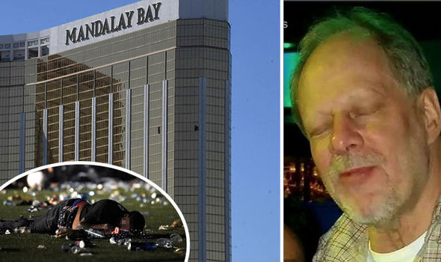
Moral Evil
Notes:
Stephen Paddock
2017: From his suite on the 32nd floor of the Mandalay Bay Resort & Casino, Paddock, 64, fired bullets into a sea of people attending a music festival on the Las Vegas Strip. Fifty-eight people were killed and more than 800 were injured in what is considered the worst mass shooting in modern American history.
No clear motive has been discovered. As a high stakes gambler, he was on a losing streak. He may have had a mental disorder. But none of this adds up to motivate his actions.
He methodically did his research on the location of the event, the optimal height for the room, how many people would be there, he paid his gambling debts, sent his girlfriend on a trip to see her family, and proceeded to open fire on a helpless crowd.

Slide 4
Pain and suffering
Notes:
Kevin Carter
Attempting to get to her parents who were themselves trying to get food from a United Nations feeding center, this little girl stops to rest. The vulture seems to sense it may be feeding time for it instead.
Kevin Carter, a photojournalist from South Africa, snaps this photo in the Sudan. He had to wait about 20 minutes for the vulture to get close enough. After the shot, he chased the vulture away. It’s not known what happened to the little girl.
When asked why he didn’t help the girl, Carter described a situation where there were many, many in this same situation and there was nothing that would have changed the situation.
In 1994, Kevin Carter won the Pulitzer prize for the disturbing photograph of a Sudanese child being stalked by a vulture. That same year, Kevin Carter committed suicide.
https://rarehistoricalphotos.com/vulture-little-girl/

Slide 5
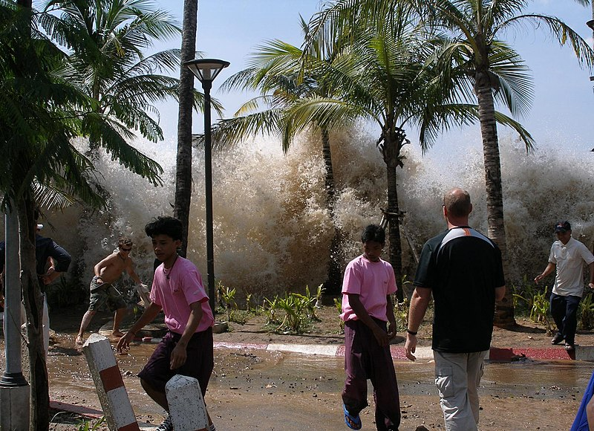
Problem of Pain
Notes:
2004 Indian Ocean Earthquake and Tsunami
3rd largest earthquake recorded that created a series of Tsunami’s. The aftershocks alone would have been massive earthquakes in their own right.
Upwards to 280,000 people died in this event.

Slide 6
Problem of Pain
Notes:
At two-years-old, Chase was diagnosed with an aggressive but rare cancer in his brain, spine, and central nervous system.
https://www.christianitytoday.com/women/2016/april/my-toddler-survived-brain-cancer-heres-what-we-learned.html

Slide 7
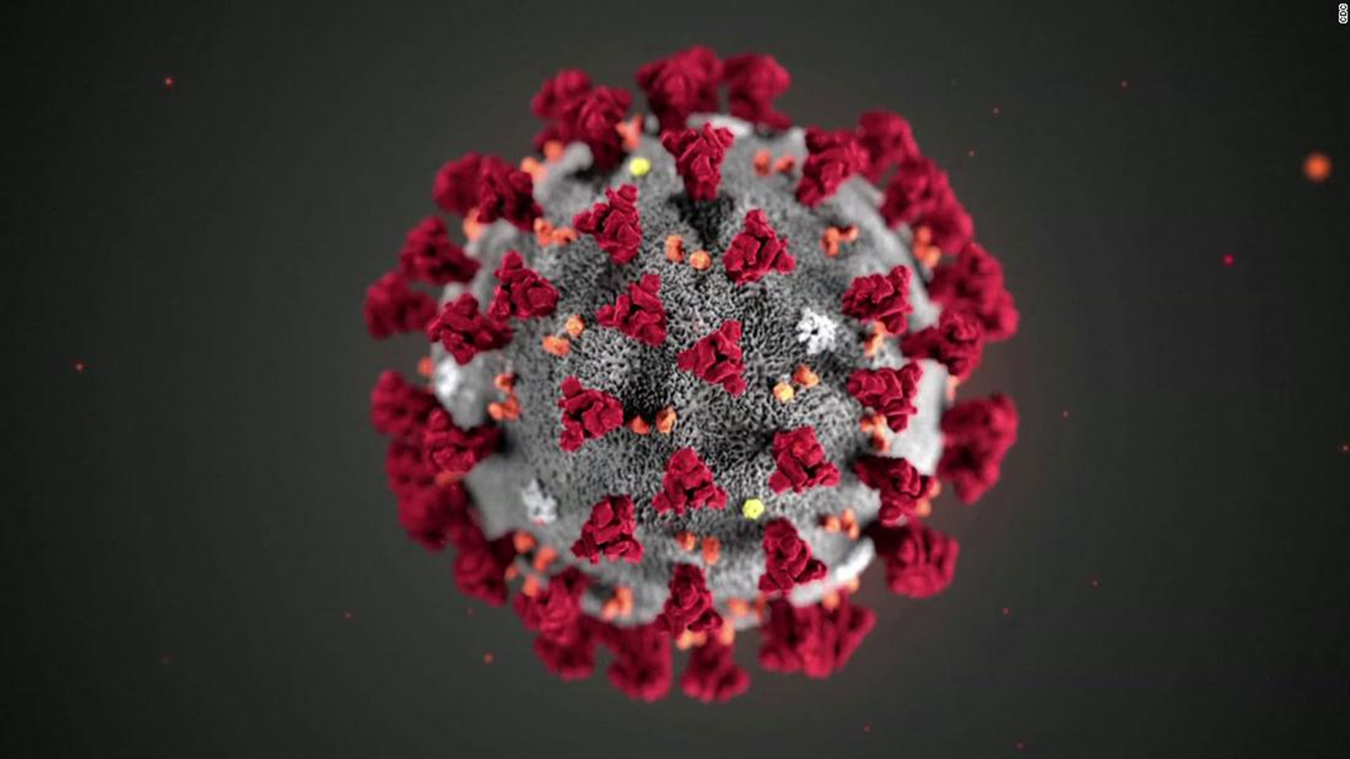
Pain and suffering
Notes:
COVID-19

Slide 8
Problem of Evil
Question: If there is a God, then why is there so much evil?
If God can do anything, he can eliminate evil.
If God is loving and good, he ought to eliminate evil.
But there’s evil.

Slide 9
Problem of Evil
Evil is often given as an objection for the God of the Bible.
The God of the Bible is loving, all good and all powerful.
Problem: Since evil exists, God does not exist.

Slide 10
Problem of Evil
Inadequate responses:
You can’t have good without evil.
It’s just the discipline of a loving father.
God can do anything and so God can do evil.

Slide 11
Problem of Evil
Proper Response:
God allows evil for good reasons.
What’s the good reason?
You!
Genuine love requires genuine freedom
Genuine worship requires genuine freedom

Slide 12
Problem of Pain
Problem: A world with so much pain and suffering seems God-less.

Slide 13
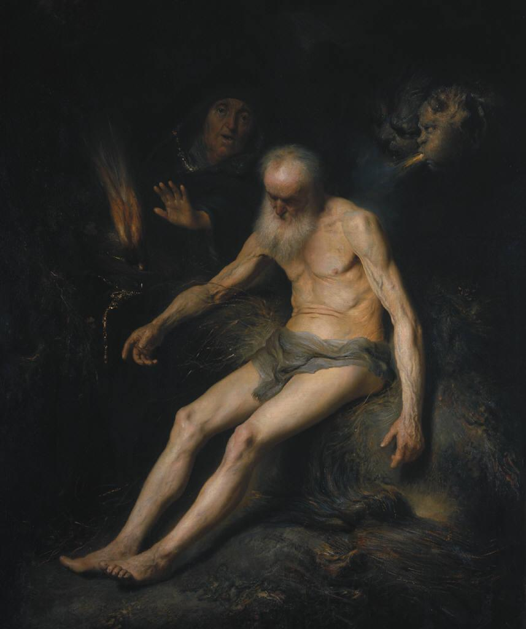
Problem of pain
Job

Slide 14
Problem of Pain
Romans 8:18-28
¹⁸ For I consider that the sufferings of this present time are not worth comparing with the glory that is going to be revealed to us. ¹⁹ For the creation eagerly waits with anticipation for God’s sons to be revealed.
Notes:
We are not the point. God is. (Col. 1:16)

Slide 15
Problem of Pain
²⁰ For the creation was subjected to futility—not willingly, but because of him who subjected it—in the hope ²¹ that the creation itself will also be set free from the bondage to decay into the glorious freedom of God’s children.
Notes:
We are not the point. God is. (Col. 1:16)

Slide 16
Problem of Pain
²² For we know that the whole creation has been groaning together with labor pains until now. ²³ Not only that, but we ourselves who have the Spirit as the firstfruits—we also groan within ourselves, eagerly waiting for adoption, the redemption of our bodies.
Notes:
We are not the point. God is. (Col. 1:16)

Slide 17
Problem of Pain
²⁴ Now in this hope we were saved, but hope that is seen is not hope, because who hopes for what he sees? ²⁵ Now if we hope for what we do not see, we eagerly wait for it with patience.
Notes:
We are not the point. God is. (Col. 1:16)

Slide 18
Problem of Pain
²⁶ In the same way the Spirit also helps us in our weakness, because we do not know what to pray for as we should, but the Spirit himself intercedes for us with inexpressible groanings. ²⁷ And he who searches our hearts knows the mind of the Spirit, because he intercedes for the saints according to the will of God.
Notes:
We are not the point. God is. (Col. 1:16)

Slide 19
Problem of Pain
²⁸ We know that all things work together for the good of those who love God, who are called according to his purpose.
Notes:
We are not the point. God is. (Col. 1:16)

Slide 20
1. consequences of the fall
1. There are far reaching consequences of living in a fallen world. (vs. 19-22)
God is under no obligation to make our lives pleasurable.
God is also under no obligation to answer our why questions.

Slide 21
1. consequences of the fall
The lesson of Job:
We don’t need to know God’s purpose for our pain to know…
He’s there
He is good
He is in control (i.e., has a purpose).

Slide 22
2. God is with us in suffering
2. God is present with us through our suffering. (vs. 26-27)
“…the Spirit helps us in our weakness…” (v. 26)

Slide 23
3. God’s good plan
3. There’s a hope! (vs. 18-19; 23-25; 28)
We can face all things given the incomparable value of the future glory of heaven. (vs. 18-19)
All things work together for our good! (v. 28)

Slide 24
3. God’s good plan
Despite our sin, God has provided for the redemption of mankind.
So the ultimate answer to all problems of evil and our suffering is the cross.
“How to get God off the hook? God’s answer is Jesus. Jesus is not God off the hook but God on the hook” (Kreeft)

