Slide 1
What is Faith?
Travis Dickinson
www.travisdickinson.com

Slide 2
What is Faith?
Mark Twain: “Faith is believing what you know ain’t so.”

Slide 3
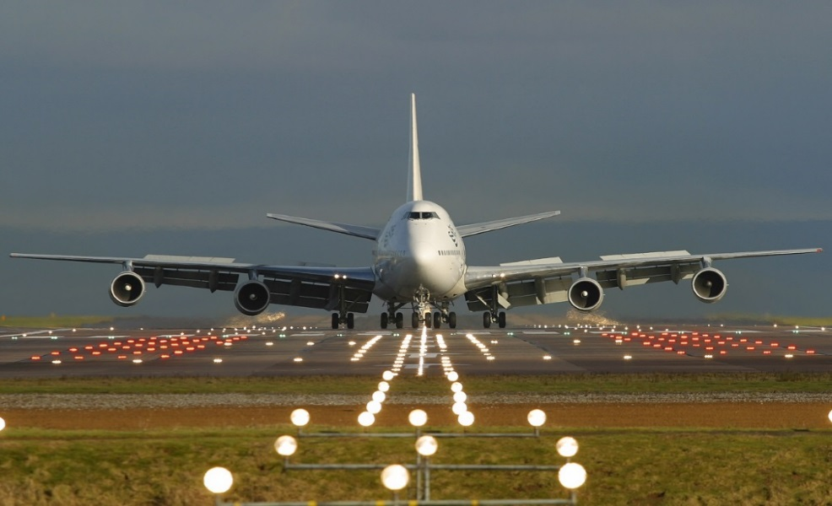
What is Faith?

Slide 4
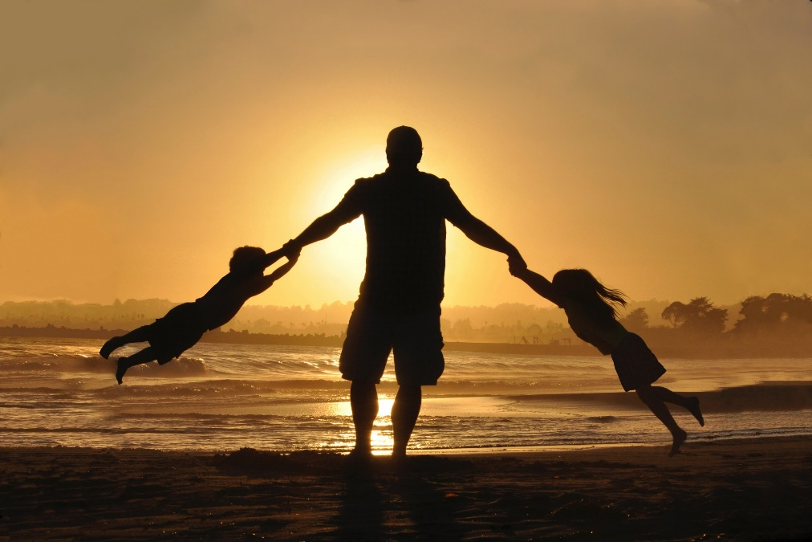
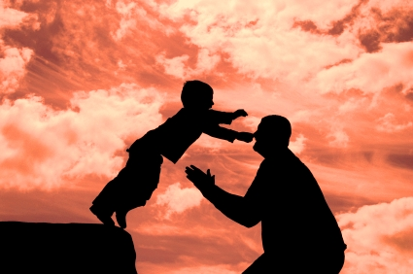
But aren’t we told to have childlike faith?
Notes:
Matthew 18
James 1:6 But he must ask in faith without any doubting, for the one who doubts is like the surf of the sea, driven and tossed by the wind.

Slide 5
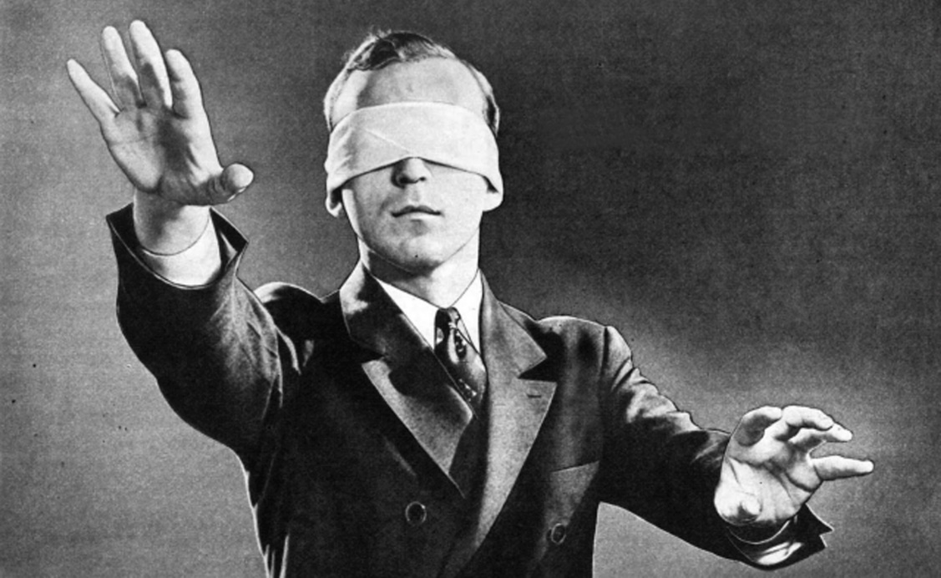
Isn’t faith supposed to be a blind leap?
Notes:
Hebrews 11:1 “Now faith is the assurance of things hoped for, the conviction of things not seen.” (NASB)

Slide 6
What is Faith?
Let’s take a trip!!

Slide 7
What is Faith?

Slide 8
What is Faith?
How should we think about faith?

Slide 9
What is Faith?
Faith is a form of trust.
Notes:
It can be used this way. “I hold to the tenets of the Christian faith.” or when Jude says his purpose in writing is so that his readers would “contend for the faith,” these probably have something like a set of claims or beliefs in mind.
Christian Faith should not be equated with mere intellectual belief. Even the demons believe—and they shudder (James 2:19). And even many Southern Baptists intellectually believe and they don’t shudder but they do show up on Christmas and Easter and it has no discernable effect on their lives. They may intellectually believe, in some sense, the gospel is true and yet they have never placed their faith in Christ.
Whenever the NT mentions saving belief (such as John 3:16) it is the just the verb form of the noun faith. It is usually translated as “believe in” rather than “believe that.”

Slide 10
What is Faith?
Hebrews 11:1*
“Now faith is the blind assurance of things hoped for against all actual evidence, the irrational conviction of things not seen (like Santa and fairies).” (NNASB)

Slide 11
What is Faith?
Hebrews 11:1*
“Now faith is the blind assurance of things hoped for against all actual evidence, the irrational conviction of things not seen (like Santa and fairies).” (NNASB)

Slide 12
What is Faith?
Hebrews 11:1
“Now faith is the assurance of things hoped for, the conviction of things not seen.” (NASB)
Notes:
The writer of Hebrews is not writing a Bible dictionary. He is characterizing faith in God and then giving a list of examples of what is in mind.
Let’s imagine you are getting married. You have dated, been engaged, and now you are taking the big next step. You are going to be placing your faith in your soon-to-be spouse in a new and deeper way. You hope your spouse will be a committed and loving partner for life. In a healthy marriage, this is an assured hope. But it is a future unseen hope. In a healthy relationship, one has a hard and fast rational conviction about this unseen future that is lived out by entrusting oneself to our soon-to-be spouse.
This is what we see in the examples throughout Hebrews 11.

Slide 13
What is Faith?
Faith as ventured trust.
It is when we venture, risk, and entrust ourselves and our wellbeing to someone or something.
Notes:
Faith is trust but it is trust in action. We always venture or risk something. Getting on the airplane.
We don’t have faith in our spouse unless we risk ourselves and our wellbeing on our spouse. This opens us up to the deepest hurt when there is betrayal and a toxic marriage is of course one in which there is deep distrust and suspicion.
When it comes to people, how we entrust ourselves to others depends on what kind of relationship it is. A marriage calls for a certain kind of faith different from a coworker. The faith I have in my pastor is different from the faith I have in my tax guy. The faith called for in being rightly related to God is unlike any human relation (the bible gives analogies: marriage, parent/child, king, etc. but these all fall short).

Slide 14
The Role of Evidence
Faith can be good or bad, vicious or virtuous.
One can venture trust in reasonable or unreasonable ways.
Notes:
Everyone has faith in this sense.

Slide 15
The Role of Evidence
We need evidence that someone or something is trustworthy—or faithworthy.

Slide 16
The Role of Evidence
With evidence, we then have an assurance of things hoped for and confidence of things unseen.

Slide 17
The Role of Evidence
We need evidence to believe…
a person is a friend.
a person is competent and capable.

Slide 18
The Role of Evidence
The greatest evidence of being a friend is the willingness to lay down one’s life for someone
Notes:
(Jn. 15:13)

Slide 19
Christian Faith
The Christian gospel:
God is omnipotently competent.
God loves us and gave his Son for us.
This calls for faith!

