Slide 1
False Idea: Doubt is Dangerous
Travis Dickinson | www.travisdickinson.com

Slide 2
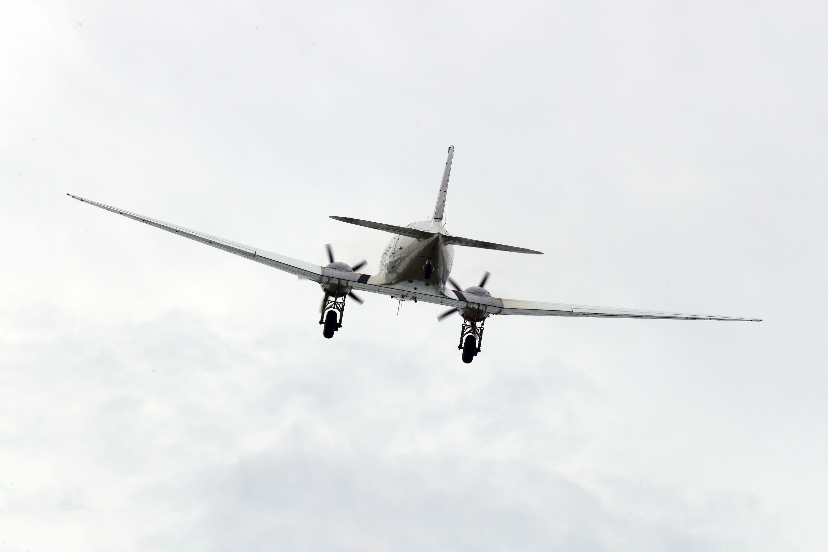
Do you fly?

Slide 3
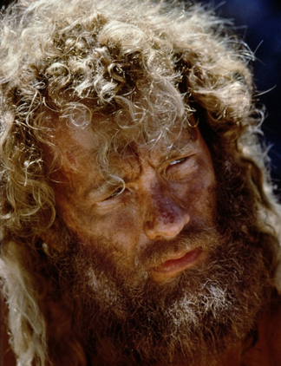
Notes:
You notice someone who looks oddly like Tom Hanks in the movie Castaway (he’s been there a while) who you’ve also noticed never seems to board a flight. So you engage this person and he raises a series of questions that you’ve never thought about before.
Do you know how much an airplane weighs? 1 million pounds
Do you know what an airplane is made of? Mostly steel (heavy stuff)
Do you know how many things have to be timed perfectly for a plan to function at all? 100s of thousands of processes having to work with pinpoint accuracy or you fall out of the sky
Is it your experience that typically things weighing a million pounds, being made of steel, requiring pinpoint accuracy with 100s of thousands of processes are able to cruise 6 miles off the ground?
Have a great flight. You’d be a dummy to entrust your life to this sort of thing!

Slide 4
Walking away
60% of Christian youth walk away from the church in college.
Why?
Some just freely choose to.
Some are emotionally hurt.
Some are disappointed by our prosperity gospels

Slide 5
Walking away
Some haven’t been allowed to doubt and deeply question their faith.
Typical prescription for doubt:
Knock it off!!
Pray it out.

Slide 6
What is doubt?
Feeling the pull or force of an objection.
Finding a claim against Christianity plausible.

Slide 7
Questions and Objections
Do you still believe Santa and the Tooth Fairy? If not, then you shouldn’t believe in the stories of God and Jesus.
Do you know when the stories about Jesus were recorded? Decades after his death.
The earliest full manuscripts come centuries later.
There are hundreds of contradictions in Scripture.
Out of all the religions out there, there’s little chance yours happens to be the right one?

Slide 8
Questions and Objections
God couldn’t exist with so much evil, pain and suffering.
God wants us to believe in him but then he hides himself so that most of the world never finds him. Does this sound just?
And if we don’t believe in him during our short lives, then we get punished for an eternity in hell? Could this possibly be the act of a loving and just God?
How can you be a part of a church responsible for so much injustice?
The Bible is out of step with science (evolution), culture (sex and gender issues) and morality.

Slide 9
The Value of Doubt
If you doubt, you’re normal!!
Doubt, when handled properly, leads to…
Truth and knowledge.
An even greater faith.

Slide 10
How to Doubt Well
Hang on!
Doubts and objections should not straightaway defeat our beliefs.
You can have full faith in someone or something even when you are doubting.
Notes:
Would you get on the flight?
I’m not saying ignore the challenge. You’ll need to address the problem. How’s the best way to do this? In community…this leads to my next point.

Slide 11
How to Doubt Well
Doubt your doubts
Doubts need evidence!
We need to investigate our doubts.
Notes:
We need to ask what reasons we have for believing the doubt is true.
It is practically impossible that you will stumble on a problem that no one in the history of Christianity has ever worked on. You are not alone in this.
I have sometimes found students struggling deeply with a challenge that has been so thoroughly addressed that most non-Christians don’t even think it is a good argument.
Or it is something that Augustine thoroughly refuted 16 centuries ago (4th century).
What do you think about the problem of evil? How do you reconcile alleged contradiction in Scripture? Is there such thing as truth and can I know it? How can we reasonably believe in miracles in our modern scientific age? What do I say to the Catholic or the Mormon or the JW or Muslim?

Slide 12
Let’s Ask a Difficult Question
Belief: Scripture is true and trust worthy.
But…
“Mary Magdalene and the other Mary came to look at the grave” (Matt. 28:1).
“Mary Magdalene, and Mary the mother of James, and Salome…came to the tomb when the sun had risen” (Mark 16:1–2).
“Now they were Mary Magdalene and Joanna and Mary the mother of James; also the other women with them” (Luke 24:10).
“Mary Magdalene came early to the tomb” (John 20:1).
Notes:
Steve begins to find plausible the idea that there these passages contradict.
He does not believe that they contradict.
But he does believe that if they contradict, then his belief that Scripture is without error is defeated.

Slide 13
Let’s Ask a Difficult Question
These are different…
“Mary Magdalene and the other Mary” (Matthew).
“Mary Magdalene, and Mary the mother of James, and Salome” (Mark).
“Mary Magdalene and Joanna and Mary the mother of James; also the other women” (Luke).
“Mary Magdalene” (John).
But are they contradictory?
No!
Notes:
Steve begins to find plausible the idea that there these passages contradict.
He does not believe that they contradict.
But he does believe that if they contradict, then his belief that Scripture is without error is defeated.

Slide 14
Isn’t faith supposed to be a blind leap?
Notes:
Hebrews 11:1 “Now faith is the assurance of things hoped for, the conviction of things not seen.” (NASB)

Slide 15
But aren’t we told to have childlike faith?
Notes:
Matthew 18
James 1:6 But he must ask in faith without any doubting, for the one who doubts is like the surf of the sea, driven and tossed by the wind.

Slide 16
Doubt
We should ask questions in order to pursue God!
In the words of Jesus…
Matt. 22:37-38: Jesus replied: “‘Love the Lord your God with all your heart and with all your soul and with all your mind.’ This is the first and greatest commandment.

Slide 17
Doubt
Is it dangerous to doubt?
It may be more dangerous to not doubt.
Christianity can handle your questions.
Doubts, when handled properly, can lead to…an even greater faith!!

Slide 18
www.travisdickinson.com

