Slide 1
Permission to doubt Your faith
Travis Dickinson | www.travisdickinson.com

Slide 2
Do you fly?

Slide 3
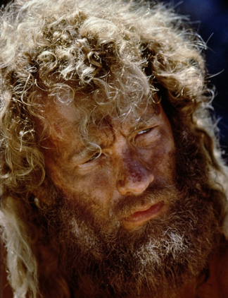
Notes:
You notice someone who looks oddly like Tom Hanks in the movie Castaway (he’s been there a while) who you’ve also noticed never seems to board a flight. So you engage this person and he raises a series of questions that you’ve never thought about before.
Do you know how much an airplane weighs? 1 million pounds
Do you know what an airplane is made of? Mostly steel (heavy stuff)
Do you know how many things have to be timed perfectly for a plan to function at all? 100s of thousands of processes having to work with pinpoint accuracy or you fall out of the sky
Is it your experience that typically things weighing a million pounds, being made of steel, requiring pinpoint accuracy with 100s of thousands of processes are able to cruise 6 miles off the ground?
Have a great flight. You’d be a dummy to entrust your life to this sort of thing!

Slide 4
Doubting
Typical prescription for doubt
Wait it out
Treat symptoms as best you can
Hope it goes away
What if this doesn’t work?

Slide 5
Making your faith your own
60% of Christian youth walk away from the church in college.
Why?
Some just want to walk away.
My thesis: Some don’t want to…
They haven’t been allowed to doubt properly.

Slide 6
What is Doubt?
Feeling the pull or force of an objection.
Finding a claim against Christianity plausible.

Slide 7
Objections
Do you still believe in the stories of Santa and the Tooth Fairy, then why believe in the stories of God and Jesus? (Objection from mockery)
Do you know when the stories about Jesus were recorded? Decades after his death.
Don’t you know that there are hundreds of contradictions in Scripture?
What’s the chance your worldview happens to be the right one?

Slide 8
Objections
How could God allow so much evil?
God wants us to believe in him but then he hides himself so that most of the world never finds him. Does this sound just?
And if we don’t believe in him during our short lives, then we get punished for an eternity in hell? Could this possibly be the act of a loving and just God?
How can you be a part of a church responsible for so much injustice?
The Bible is out of step with science (evolution), culture (sex and gender issues) and morality.

Slide 9
Isn’t Doubt Sin?
Is doubt sin (James 1:6-8)?
Sin always involves choice.
Sometimes we choose to doubt and this can be sin.
Sometimes we don’t get a choice.
Notes:
The doubt of John the Baptist (Matt. 11:2-3)
Luke 7:28 “I tell you, among those born of women no one is greater than John…”

Slide 10
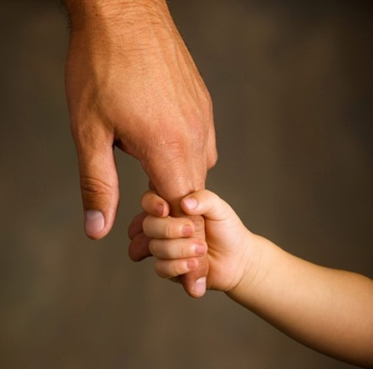
Isn’t Doubt Sin?
Aren’t we told to have childlike faith?
Notes:
Matthew 18
James 1:6 But he must ask in faith without any doubting, for the one who doubts is like the surf of the sea, driven and tossed by the wind.

Slide 11
Doubt?
Asking hard questions (apologetics) should just be a normal part of our Christian walk.
Doubt, when handled properly, leads to…
Truth
Knowledge
An even greater faith.

Slide 12
How to Doubt Well
Hang on!
Doubts and objections should not straightaway defeat our beliefs.
How many of you will get on the airplane?
Notes:
Would you get on the flight?
I’m not saying ignore the challenge. You’ll need to address the problem. How’s the best way to do this? In community…this leads to my next point.

Slide 13
How to Doubt Well
Doubt your doubts
Doubts need evidence!
We need to ask what reasons we have for believing the doubt is true.
We need to investigate our doubts.
Notes:
It is practically impossible that you will stumble on a problem that no one in the history of Christianity has ever worked on. You are not alone in this.
I have sometimes found students struggling deeply with a challenge that has been so thoroughly addressed that most non-Christians don’t even think it is a good argument.
Or it is something that Augustine thoroughly refuted 16 centuries ago (4th century).
What do you think about the problem of evil? How do you reconcile alleged contradiction in Scripture? Is there such thing as truth and can I know it? How can we reasonably believe in miracles in our modern scientific age? What do I say to the Catholic or the Mormon or the JW or Muslim?

Slide 14
Apologetics as Devotional
Are you curious about God? Do You have a few questions?
The God of the Bible is anything but simple and obvious.
Christianity can handle your questions!
You won’t get all your questions answered.
We do need enough of our questions answered.
Notes:
we typically do a pretty good job at seeking God with our emotions. We have Passion concerts and conferences and probably you have been to a youth retreat or two. The basic message is to get pumped up for Jesus and go out there an change the world.
How does that usually go for you? For me…

Slide 15
Let’s Ask a Hard Question
How do you know most of what you know about Christianity?
Answer: God has revealed it in Scripture.
How do you know that Scripture tells the truth?
Notes:
We cannot give a full treatment here. Ultimately, there is good reason to believe that Scripture is authored by God. There are many portions of it that break from popular ancient cultures (In the beginning God created the heavens and the earth)

Slide 16
Contradictions?
If there are contradictions, then this would be a big problem.
Contradiction= two claims that can’t both be true.
For example:
The Cowboys are the best team in the NFL.
The Cowboys are not the best team in the NFL.
Notes:
Romney lost the 2012 presidential election and won the Massachusetts gubernatorial election of 2002.

Slide 17
Let’s Ask a Hard Question
Belief: Scripture is true and trust worthy.
But…
“Mary Magdalene and the other Mary came to look at the grave” (Matt. 28:1).
“Mary Magdalene, and Mary the mother of James, and Salome…came to the tomb when the sun had risen” (Mark 16:1–2).
“Now they were Mary Magdalene and Joanna and Mary the mother of James; also the other women with them” (Luke 24:10).
“Mary Magdalene came early to the tomb” (John 20:1).
Notes:
Steve begins to find plausible the idea that there these passages contradict.
He does not believe that they contradict.
But he does believe that if they contradict, then his belief that Scripture is without error is defeated.

Slide 18
Let’s Ask a Hard Question
These are different…
“Mary Magdalene and the other Mary” (Matthew).
“Mary Magdalene, and Mary the mother of James, and Salome” (Mark).
“Mary Magdalene and Joanna and Mary the mother of James; also the other women” (Luke).
“Mary Magdalene” (John).
But are they contradictory?
No!
Notes:
Steve begins to find plausible the idea that there these passages contradict.
He does not believe that they contradict.
But he does believe that if they contradict, then his belief that Scripture is without error is defeated.

Slide 19
Doubt
We should ask questions in pursuit of God!
In the words of Jesus…
Matt. 22:37-38: Jesus replied: “‘Love the Lord your God with all your heart and with all your soul and with all your mind.’ This is the first and greatest commandment.

Slide 20
Doubt
Christianity can handle your questions.
This is why, when handled properly, doubts can lead to…an even greater faith!!

Slide 21
www.travisdickinson.com

