Slide 1
Is There More than One Way to God?
Travis Dickinson
www.travisdickinson.com

Slide 2
“The Blind Men and the Elephant”
There were a group of blind men who came upon an elephant for the first time. Since they are blind, they each attempt to understand what is before them by feeling the elephant. The first feels the side of the elephant and takes it to be like a wall. The second happens upon the trunk of the elephant and takes it to be long like a snake.

Slide 3
“The Blind Men and the Elephant”
The third touches the tusk and thinks an elephant is like a spear. The fourth feels the leg of the elephant and takes elephants to be like tree trunks. The fifth feels the ear and thinks elephants are like fans. And the sixth thinks an elephant is like a rope given that he feels the tail.

Slide 4
Introduction
Yesterday…
“My religion is true.”
“My religion is the way to get to God.”
Today…
“My religion is true, for me.”
“My religion is my way to relate to God.”
Notes:
Talk about how this makes it harder to make a case for Christianity.

Slide 5
Introduction
Religious Pluralism
All religious beliefs are true, or at least provide a way to God.
Notes:
It used to be we all disagreed. Today the situation is a bit more muddled and being muddled has a name:

Slide 6
Introduction
Christian Exclusivism
Jesus Christ is the unique way of salvation.
Salvation is through explicit faith in Jesus Christ.

Slide 7
Introduction
Two reasons to think that Jesus is the unique way of salvation:
Jesus and His apostles, in no uncertain terms, say so.
The gospel itself makes Jesus unique and his work on the cross final.
Notes:
John 14:6; Acts 4:12

Slide 8
Religious Pluralism
Simple religious pluralism (Simple RP): all or most religious views are literally correct.
Everybody is right about everything!

Slide 9
Simple Religious Pluralism
Problem #1: Simple RP is logically incoherent!
God is a Trinity
God is one in all senses
There is no God
These cannot all be true as a matter of logic.
Notes:
Each of these could perhaps be false (i.e., polytheism could be true)
One could (in word) deny logic…but go ahead and try it.

Slide 10
Simple Religious Pluralism
Problem #2: Simple RP is self-refuting!
Examples:
(Saying in English) “I speak no English”
“All sentences longer than seven words are false.”
“There is no absolute truth”
“All views are equally true.”
Notes:
Self-Refutation: when what a claim asserts actually falsifies the claim itself.

Slide 11
Simple Religious Pluralism
“Religious Pluralism is false.”
“If you believe RP is true, then you should pay me $100”
“Anyone who believes RP should be shot”

Slide 12
Simple Religious Pluralism
Isn’t it arrogant and intolerant to be religiously exclusive?
No more arrogant than claiming that Simple RP is true.
Notes:
Claims themselves are not arrogant.

Slide 13
Simple Religious Pluralism
Today, the primary societal value is tolerance and acceptance. It is completely unacceptable to claim that one has the exclusive corner on the market of truth. Any such person is simply wrong and deserves the scorn he or she will inevitably receive. This person needs not have a voice or any representation in our pluralist society. We only have room for those who celebrate tolerance and acceptance.

Slide 14
Simple Religious Pluralism
Today, the primary societal value is tolerance and acceptance. It is completely unacceptable to claim that one has the exclusive corner on the market of truth. Any such person is simply wrong and deserves the scorn he or she will inevitably receive. This person needs not have a voice or any representation in our pluralist society. We only have room for those who celebrate tolerance and acceptance.

Slide 15
Simple Religious Pluralism
Today, the primary societal value is tolerance and acceptance. It is completely unacceptable to claim that one has the exclusive corner on the market of truth. Any such person is simply wrong and deserves the scorn he or she will inevitably receive. This person needs not have a voice or any representation in our pluralist society. We only have room for those who celebrate tolerance and acceptance.
Notes:
Arrogance is an attitude that people have.

Slide 16
Simple Religious Pluralism
Today, the primary societal value is tolerance and acceptance. It is completely unacceptable to claim that one has the exclusive corner on the market of truth. Any such person is simply wrong and deserves the scorn he or she will inevitably receive. This person needs not have a voice or any representation in our pluralist society. We only have room for those who celebrate tolerance and acceptance.
Notes:
Arrogance is an attitude that people have.

Slide 17
Simple Religious Pluralism
Today, the primary societal value is tolerance and acceptance. It is completely unacceptable to claim that one has the exclusive corner on the market of truth. Any such person is simply wrong and deserves the scorn he or she will inevitably receive. This person needs not have a voice or any representation in our pluralist society. We only have room for those who celebrate tolerance and acceptance.
Notes:
Arrogance is an attitude that people have.

Slide 18
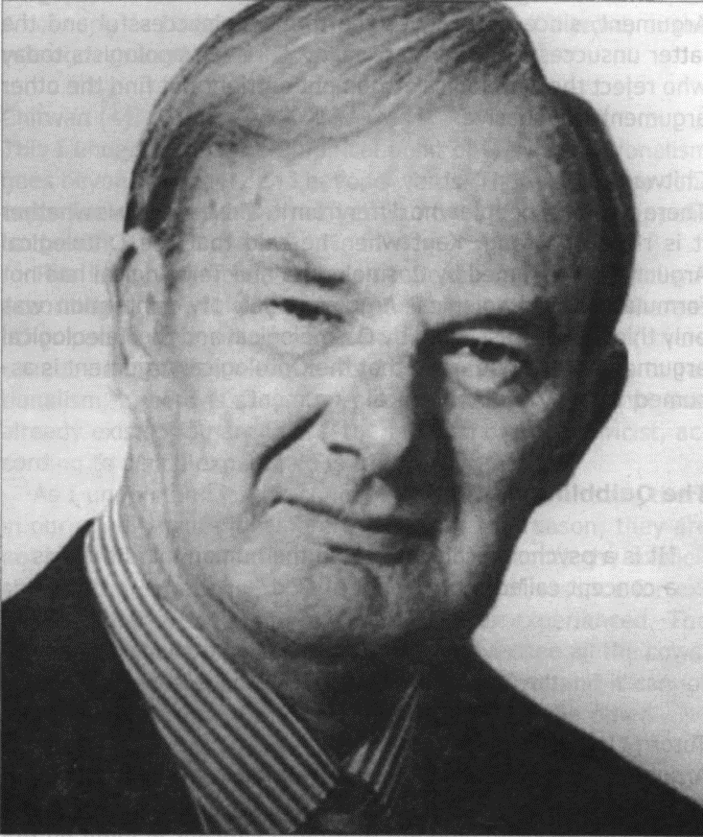
Religious Pluralism
Sophisticated Religious Pluralism:
All religions are, strictly speaking, false in the specific claims they make.
But they are all pointing us to some indescribable, transcendent reality (i.e., the Real).
Notes:
Indescribable in literal terms.

Slide 19
Religious Pluralism
But how does the sophisticated RP know they are all pointing us to the Real?
Blind Men and the Elephant

Slide 20
Religious Pluralism
As it turns out, we cannot avoid exclusivity.
Making any claim whatsoever implies that its contrary claims are all false.
If exclusivity is unavoidable, pluralism is false.
Notes:
Try it…
“Everyone, no matter what they believe, is right.”

Slide 21
Religious Pluralism
If so, we take each view on its own terms.
In other words, we should look to reason and evidence.
The case for Christianity is robust and unlike any other religion.
Notes:
Try it…
“Everyone, no matter what they believe, is right.”

