Slide 1
Is the God of the Old Testament a moral monster?
Travis Dickinson | www.travisdickinson.com

Slide 2
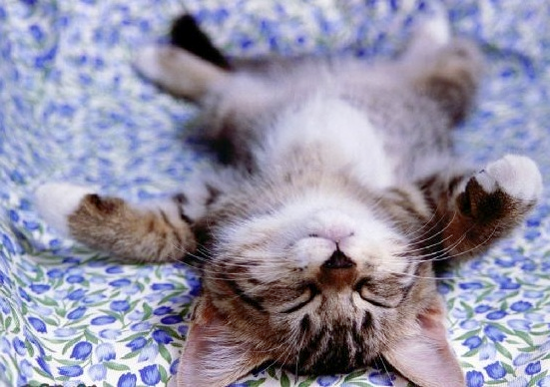
The Old Testament God
There are things in the Bible I don’t like.
But being unpleasant is not necessarily being immoral.

Slide 3
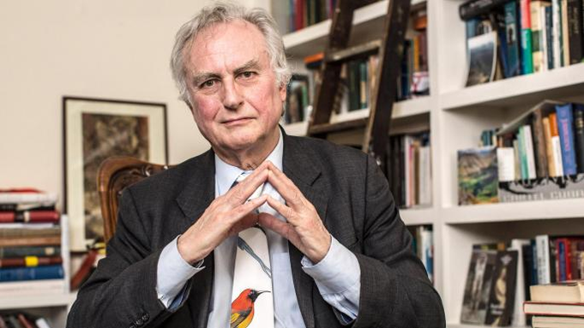
“The God of the Old Testament is arguably the most unpleasant character in all fiction: jealous and proud of it; a petty, unjust, unforgiving control-freak; a vindictive, bloodthirsty ethnic cleanser; a misogynistic, homophobic, racist, infanticidal, genocidal, filicidal, pestilential, megalomaniacal, sadomasochistic, capriciously malevolent bully.“
-Richard Dawkins

Slide 4
“The universe we observe has precisely the properties we should expect if there is, at bottom, no design, no purpose, no evil, no good, nothing but blind, pitiless indifference.”
–Richard Dawkins

Slide 5
“The God of the Old Testament is arguably the most unpleasant character in all fiction: jealous and proud of it; a petty, unjust, unforgiving control-freak; a vindictive, bloodthirsty ethnic cleanser; a misogynistic, homophobic, racist, infanticidal, genocidal, filicidal, pestilential, megalomaniacal, sadomasochistic, capriciously malevolent bully.“
-Richard Dawkins

Slide 6
“The God of the Old Testament is arguably the most unpleasant character in all fiction: jealous and proud of it; a petty, unjust, unforgiving control-freak; a vindictive, bloodthirsty ethnic cleanser; a misogynistic, homophobic, racist, infanticidal, genocidal, filicidal, pestilential, megalomaniacal, sadomasochistic, capriciously malevolent bully.“
-Richard Dawkins

Slide 7
Genocide?
Did God command genocide?
Did God commit genocide?
Would God be justified in commanding or committing the killing of whole people groups?
Notes:
When the Lord your God brings you into the land where you are entering to possess it, and clears away many nations before you…you shall utterly destroy them. You shall make no covenant with them and show no favor to them. Furthermore, you shall not intermarry with them…. For they will turn your sons away from following Me to serve other gods. Then the anger of the Lord will be kindled against you and He will quickly destroy you. But thus you shall do to them: You shall tear down their altars, and smash their sacred pillars, and hew down their Asherim, and burn their graven images with fire. (Deut. 7:1-5)³
Only in the cities of these peoples that the Lord your God is giving you as an inheritance, you shall not leave alive anything that breathes. But you shall utterly destroy them, the Hittite and the Amorite, the Canaanite and the Perizzite, the Hivite and the Jebusite, as the Lord your God has commanded you, so that they may not teach you to do according to all their detestable things which they have done for their gods, so that you would sin against the Lord your God. (Deut. 20.16-18)
Now go, attack the Amalekites and totally destroy everything that belongs to them. Do not spare them; put to death men and women, children and infants, cattle and sheep, camels and donkeys.’” (1 Sam 15:2-3)

Slide 8
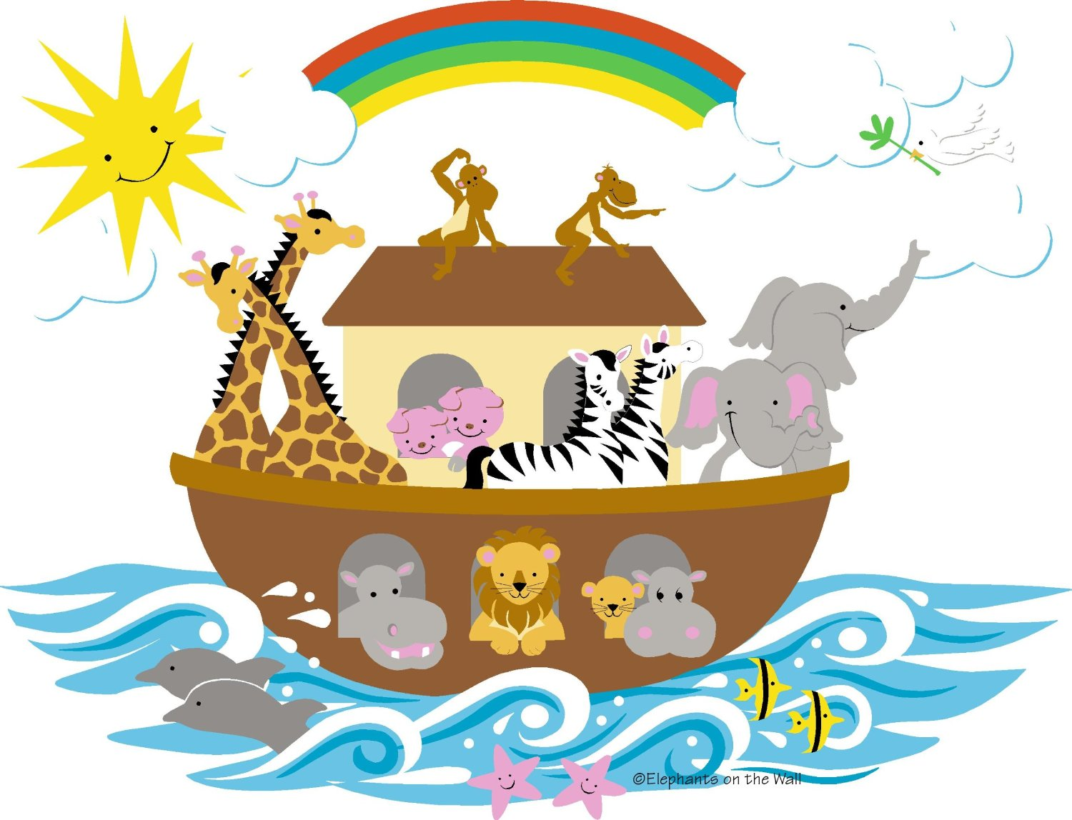
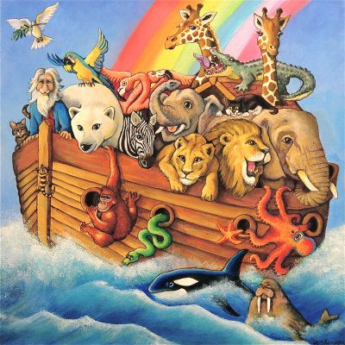
Noah’s Flood
Test case: Noah’s flood (Gen. 6-8)
Fact: God wiped out many men, women, children and animals.
Question: Was God justified?

Slide 9
Moral Questions
How do we know if someone’s action is justified?

Slide 10
Moral Questions
Notes:
It was a dark and stormy night…the masked man stood over her unconscious body. He calculated what he was going to do. There was no question that he was going to do it. The only question was how he would do it. Before him stood a display of an assortment of cold metal instruments, all of the sharp, all of them deadly. He made his selection of an especially sharp and would strike terror in any one who would see it. With trained precision he thrust the instrument into her helpless body. Through blood, bones and flesh he cut her.

Slide 11
Moral Questions
Notes:
The moral evaluation of this story changes when we find out this is a surgeon who is acting to save the life of the woman.
He is clearly justified. Not only is he not doing anything morally wrong…he’s doing something that is morally virtuous.

Slide 12
Moral Questions
With any action, we have to ask 2 questions:
Who is acting?
What is the context?
Notes:
What is the reason for acting

Slide 13
Noah’s Flood
Who is God?
God is love (1 Jn. 4:8)…
…but the biblical God is not only love!!
God is the transcendent creator (Gen. 1:1; Acts 17:24)
God is also holy (Lev. 20:26; 1 Peter 1:16).
God is also a just judge (Is. 66:16; Heb. 12:23)
Notes:
Remember the objection is that the biblical conception of God is a capricious and killing in an unjustified way.

Slide 14
Noah’s Flood
Who are the people in Noah’s day?
Rampant wickedness
What is the context?
Just judgment for wickedness
Also…
We see a grieving God (Gen. 6:6).
God saves Noah and covenants with him.
Notes:
What does it mean for God to grieve? I don’t know, but however this goes, it is not the capricious tyrant.
It’s unpleasant but is it unjust?

Slide 15
Noah’s Flood
Here’s the point:
God, as a transcendent holy judge, can take the lives of evildoers.
In fact, God is obligated to carry out justice on evildoers.
Notes:
It is not morally wrong for a judge to order an execution in appropriate circumstances nor is it wrong for an executioner to carry out the order.
We get so used to grace that we begin to demand as a matter of justice.

Slide 16
Noah’s Flood
What about the children?
All people are subject to the consequences of the fall.
Young children will experience the eternal weight of glory.
God works knowing the future.
Notes:
Children are not immune to the effects of the fall. They will die. That’s not evil of God.
2 Cor. 4:17 For momentary, light affliction is producing for us an eternal weight of glory far beyond all comparison,

Slide 17
The Burden of Proof
What would we need to know that God does something wrong?
It’s not enough to show that God acts unpleasantly.
One would have to show that God has evil intentions in these actions.

Slide 18
The Burden of Proof
It would be wrong for you and me to perform these actions.
God is not a human and shouldn’t be evaluated as if he were.
Notes:
This would be like saying a judge is wrong for sending someone to their death because it would be wrong for me to send someone to their death.

Slide 19
The Good News of God’s Justice
Why aren’t we bothered by his mercy and forgiveness?
God has justifying reasons for his mercy…
Notes:
It is not morally wrong for a judge to order an execution in appropriate circumstances nor is it wrong for an executioner to carry out the order.

Slide 20
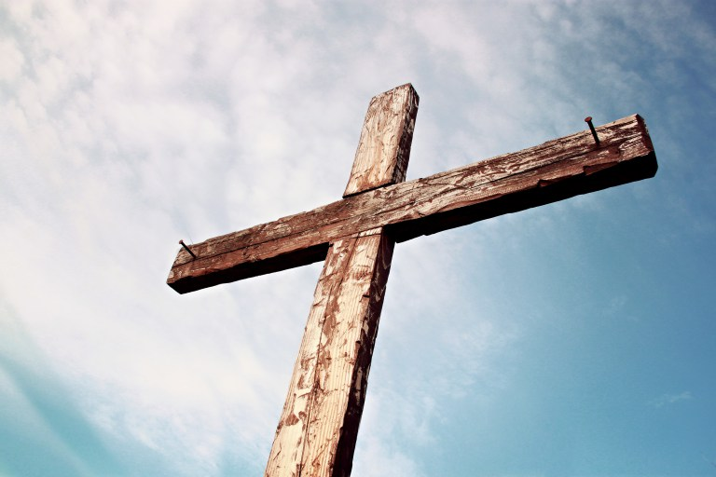
The Good News of God’s Justice
Mercy and justice come together in the cross!!
Notes:
It is not morally wrong for a judge to order an execution in appropriate circumstances nor is it wrong for an executioner to carry out the order.

Slide 21
God of the Old Testament
The Bible portrays God as transcendent, just and a holy judge.
But he is also merciful, gracious, and always redemptive.
Does this solve all issues?

