Slide 1
The Reasons for God
Christian Apologetics

Slide 2
What is apologetics?
Apologetics is offering unassuming reasons to believe that Christianity is true, good, and beautiful.
The reasons offered don’t assume Christianity is already true.

Slide 3
What is apologetics?
Apologetics, in its most basic form, should be devotional.
We ask these question as a way to know God more fully.

Slide 4
Introduction
Can we prove that Christianity is true?
No, if we mean undeniable proof.
Yes, if we mean we can provide a compelling case.
Notes:
The evidence for Christianity is widely available and easily resistible.

Slide 5
Introduction
Claim: Christianity is true
But what is truth?
Truth is when a claim matches reality.
When what we claim to be the case is the case.
Notes:
The evidence for Christianity is widely available and easily resistible.

Slide 6
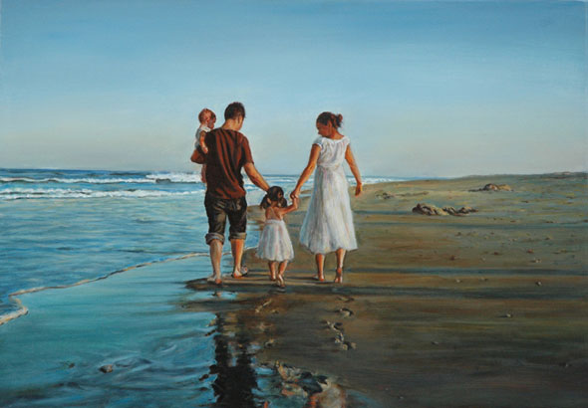
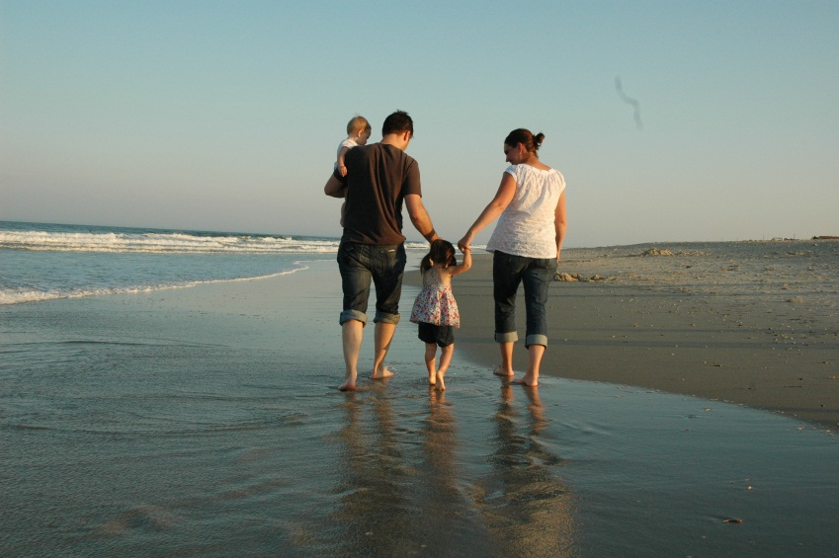
What is truth?
Claim
Truth
Fact
“God exists”
God exists
“Unicorns exists”
?

Slide 7
God is Evident
Romans 1:18-21
Claim: God is the best explanation of the world.
Without God, the world makes no sense.

Slide 8
God is Evident
Doesn’t everyone already know that God exists?
Everyone, in various ways, lives like God exists.
It is like the pacifist that beats you up when you try to take his money. Does he believe that pacifism is true?

Slide 9
The Evidence for God
Why is there something rather than nothing?
Science shows the universe began to exist.
This demands a cause.
The universe itself is evidence for God.

Slide 10
The Evidence for God
Why is there life in the universe?
The odds are significantly against us.
Everywhere we look we see fine tuning:
The big bang
Our solar system
Our planet
Our bodies (esp. DNA)
The fine tuning is evidence for God.
Notes:
The evidence for Christianity is widely available and easily resistible.

Slide 11
The Evidence for God
Why is there right and wrong?
Morality is odd.
Morality is of utmost importance.
Morality is best explained by the existence of a good God.
Right and wrong are evidence for God.
Notes:
The evidence for Christianity is widely available and easily resistible.

Slide 12
The Evidence for God
Why does life have meaning, purpose, and value?
How you live your life matters. But why?
On atheism, we are more advanced slime.
Notes:
The evidence for Christianity is widely available and easily resistible.

Slide 13
The Evidence for God
“All human beings are born free and equal in dignity and rights. They are endowed with reason and conscience and should act towards one another in a spirit of brotherhood.” (The UN Universal Declaration of Human Rights)
“We hold these truths to be self-evident, that all men are created equal, that they are endowed by their Creator with certain unalienable rights.” (US Declaration of Independence)

Slide 14
The Evidence for God
“All human beings are born free and equal in dignity and rights. They are endowed with reason and conscience and should act towards one another in a spirit of brotherhood.” (The UN Universal Declaration of Human Rights)
“We hold these truths to be self-evident, that all men are created equal, that they are endowed by their Creator with certain unalienable rights.” (US Declaration of Independence)

Slide 15
The Evidence for God
Why does life have meaning, purpose, and value?
How you live your life matters. But why?
On atheism, we are more advanced slime.
The meaning, purpose and value of life is evidence for God.
Notes:
The evidence for Christianity is widely available and easily resistible.

Slide 16
The Evidence for God
The Christian God is the best explanation for the following:
the universe itself
its fine tuning
design and order
biological life
moral facts
meaning
purpose
intrinsic human value

Slide 17
The Evidence for God
consciousness
beauty
love
mathematical facts
logical facts
the Bible itself
the Christian movement
transformed lives
religious experience
Etc.

Slide 18
The Evidence for God
These things are the most important aspects of life.
Psalm 19:1-4

Slide 19
Implications of God
We are not God.
So…
How do we live for God?
Has God spoken?
What about all of this pain and suffering?

