Slide 1
The Problem of Evil The Problem of Pain
Travis Dickinson
www.travisdickinson.com

Slide 2
The Problem

Slide 3
Moral Evil

Slide 4
Pain and suffering
Notes:
https://rarehistoricalphotos.com/vulture-little-girl/

Slide 5
What’s the problem?
3 Problems:
The emotional problem of pain and suffering
The problem of evil
The problem of pain

Slide 6
Emotional Problem of pain
This is when we experience pain and suffering, and we grieve.
This is not an intellectual problem.
Caution: Don’t attempt to “solve” this problem.
Response: Compassion, love and support
Notes:
It can be argued that Zeus does not exist.

Slide 7
Problem of Evil
Problem: Since evil exists, God does not exist.
If God can do anything, he can prevent evil.
If God is good, he ought to prevent evil.
But there’s evil.

Slide 8
Problem of Evil
Inadequate responses:
You can’t have good without evil.
It’s just the discipline of a loving father.
God can do anything and so God can do evil.

Slide 9
Problem of Evil
Response:
God allows evil for a greater good.
He has justifying reasons.
What’s the greater good?
Human freedom
Genuine love requires genuine freedom
Genuine worship requires genuine freedom

Slide 10
Problem of Pain
Problem: God is incompatible with senseless pain and suffering.

Slide 11
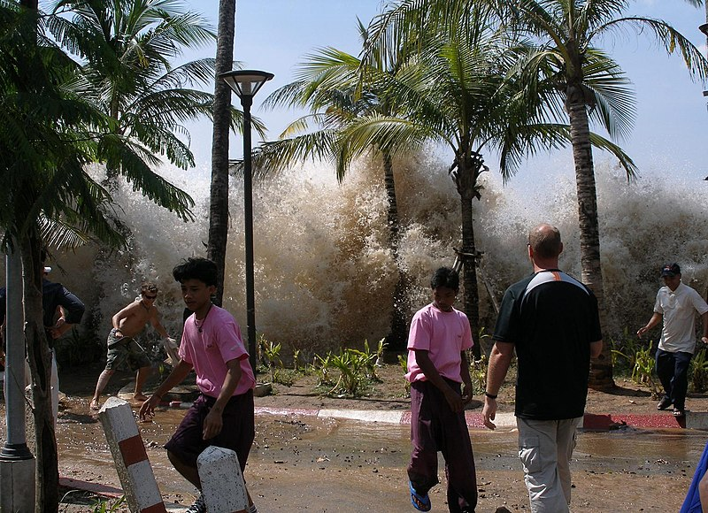
Problem of Pain

Slide 12
Problem of Pain
Notes:
https://www.christianitytoday.com/women/2016/april/my-toddler-survived-brain-cancer-heres-what-we-learned.html

Slide 13
Problem of Pain
Notes:
https://www.premierchristianity.com/Past-Issues/2016/December-2016/My-4-year-old-son-got-brain-cancer.-But-God-isn-t-to-blame

Slide 14
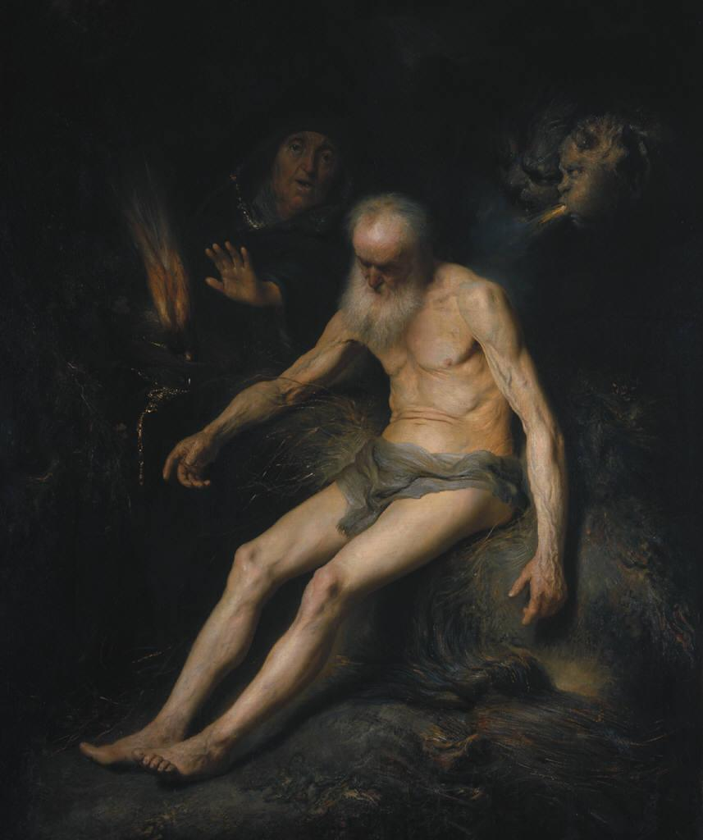
Problem of pain
Job

Slide 15
Problem of pain
We live in a fallen world.
These are consequences of the fall.
God is under no obligation to make our lives more pleasurable.
We are not the point (Col. 1:16)

Slide 16
Problem of Pain
We don’t need to know God’s purpose for our pain to know that:
God is there.
God is good.
God is in control (i.e., he has a purpose).

Slide 17
The Good News
Despite our sin, God has provided for the redemption of mankind.
So the ultimate answer to all problems of evil is the cross.
“How to get God off the hook? God’s answer is Jesus. Jesus is not God off the hook but God on the hook” (Kreeft)

